Slide 1
Cryptography and Network Security
FINITE FIELDS

Slide 2
Session Meta Data
Author | Dr T Sree Sharmila
Reviewer
Version Number | 1.0
Release Date | 26 June 2018

Slide 3
Revision History
Revision Date | Details | Version no.
 |  | 1.0

Slide 4
Agenda
Aim
Introduction
Background
Definitions
Computer Security
Personnel Security
Network Security
Internet security
Summary
Test your understanding
References

Slide 5
Introduction
of increasing importance in cryptography
AES, Elliptic Curve, IDEA, Public Key
concern operations on “numbers”
where what constitutes a “number” and the type of operations varies considerably
Groups, rings, and fields are the fundamental elements of a branch of mathematics known as abstract algebra, or modern algebra

Slide 6
A Group G
A group G, sometimes denoted by {G, .}, is a set of elements with a binary operation denoted by . that associates to each ordered pair (a, b) of elements in G an element (a . b) in G, such that the following axioms are obeyed :
Axioms:
A1 (Closure) If {a,b}∈ G, operated(a,b)∈G
A2 (Associative) law:(a·b)·c = a·(b·c)
A3 (has identity) e: e·a = a·e = a
A4 (has inverses) a’: a·a’= e
A G is a finite group if has a finite number of elements
A G is abelian if it is commutative,
A5 (has commutative) a·b = b·a, for example;
The set of positive, negative, 0, integers under addition, identity is 0, inverse element is ‘–’, inverse a = -a, a-b= a+(-b)
The set of nonzero real numbers under multiplication, identity is I, inverse element is division

Slide 7
Suppose S_{n} is to be the set of permutations of n distinct symbols: {1,2,...,n}. S_{n} is a group!!:
Suppose π, ρ ∈S_{n}; permutation operation π, and a group of S_{n} is ρ; π, ρ ∈S_{n}
A1 π₁·ρ = π₁·{1,3,2}={3,2,1}·{1,3,2}= {2,3,1}∈S_{n}
Change operator to arithmetic operators..
A2 π₂·(π₁·ρ) = {3,1,2}·{2,3,1} = {3,1,2}
∴= (π₂·π₁) ·ρ = {3,1,2}·{3,2,1}·{1,3,2}={3,1,2}
A3 identity {1, 2, 3, .., n}∈S_{n}
A4 inverse that undoes π₁ is {3,2,1}, recovering earlier positions.
{1,2,3}·{2,3,1}={2,3,1}, π₁·π₁ ={3,2,1}·{3,2,1} = {1,2,3}
A5 commutative!!.. {3,2,1}·{2,3,1}≠{2,3,1}·{3,2,1}, so S_{n} is a group but not abelian

Slide 8
Cyclic Group
A G is cyclic if every element b ∈ G is a power of some fixed element a
ie b = a^{k}
a is said to be a generator of the group G
example: a³=a.a.a and identity be: e=a⁰ =1, and a^{-n} = (a’)^{n} → a^{n} a^{-n} = 1;
The additive group of integers is an infinite cyclic group generated by the element 1. In this case, powers are interpreted additively, so that n is the n^{th} power of 1.

Slide 9
A Ring R is an abelian group with two operations (addition and multiplication), satisfies A1 to A5
A1-A5: for additiveness, identity is 0 and inverse is –a
M1: Closure under multiplication: if a,b∈R, then ab∈R.
M2: Associativity of multiplication: a(bc)=(ab)c ∈R for all a,b,c∈R.
M3: Distributive: a(b+c)=ab+ac, (a+b)c=ac+bc
WITHOUT LEAVING THE SET
M4: commutative ring if ba=ab for all a,b,ab∈R,
M5: Multiplicative identity: 1a=a1=a for all a,1,ab∈R
M6: No zero divisors: If a and b∈R and ab = 0, then either a = 0 or b = 0.
An integral domain is the one satisfies all the A1-5 and M1-6, which is then a commutative ring???, and abelian gr, and obeying M5-6. Cyclic??!!!
Notes:
In essence, a ring is a set in which we can do addition, subtraction [a – b = a + (–b)], and multiplication without leaving the set.
With respect to addition and multiplication, the set of all n-square matrices over the real numbers form a ring.
Let S be the set of even integers (positive, negative, and 0) under the usual operations of addition and multiplication. S is a commutative ring. The set of all n-square matrices defined in the preceding example is not a commutative ring.

Slide 10
Field
a set of numbers with two operations:
abelian group for addition: commutative for addition
abelian group for multiplication (ignoring 0): commutative for multiplication
It is a ring
(A1-5, M1-6), F is an integral domain.
M7: Multiplicative inverse. For each a ∈F, except 0, there is an element a⁻¹∈F such that aa⁻¹ = (a⁻¹)a = 1
Notes:
Familiar examples of fields are the rational numbers, the real numbers, and the complex numbers.
Note that the set of all integers is not a field, because not every element of the set has a multiplicative inverse; in fact, only the elements 1 and -1 have multiplicative inverses in the integers.
These are terms we use for different sorts of "number systems", ones obeying different sets of laws. From group to ring to field we get more and more laws being obeyed. As a memory aid, can use the acronym for groups is CAIN (Closure Associative Identity iNverse) & ABEL. Mostly we need to compute with Rings, if not Fields. When we do arithmetic modulo a prime, we have a field.

Slide 11
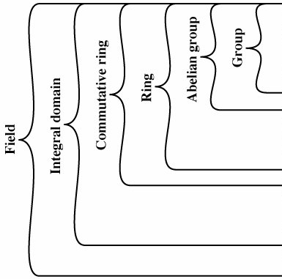
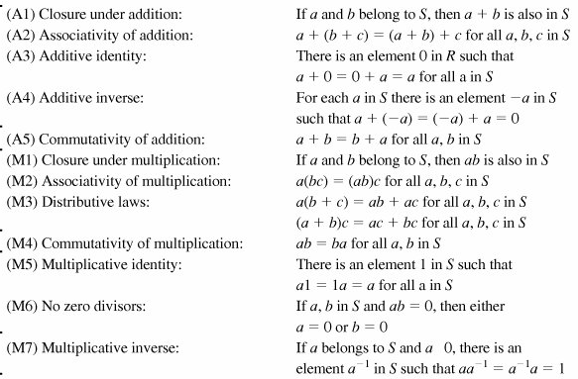

Slide 12
Modular Operations
Clock, uses a finite number of values, and loops back from either end
Associative, Distributive, Commutative,
Identities: (0 + w)%n = w%n, (1·w)%n = w%n
additive inv (-w)
If a=mb (a,b,m all integers), b|a, b is divisor (*)
Any group of integers: Z_{n} ={0,1, … ,n-1}
Form a commutative ring for addition
with a multiplicative identity
note some peculiarities
if (a+b)≡(a+c)%(n) then b≡c%(n)
but (ab)≡(ac)%(n) for all a,b,c ∈Z_{n}
then b≡ c%(n) only if a is relatively prime to n
Notes:
(*)
if
a = mb for some m, a, b, and m are integers,
no remainder left.
if a|1, then a = ±1.
if a|b and b|a, then a = ±b.
any b ≠ 0 divides 0.
If b|g and b|h, then b|(mg + nh) for arbitrary integers m and n.
-----------------
When reducing, we "usually" want to find the positive remainder after dividing by the modulus. For positive numbers, this is simply the normal remainder. For negative numbers we have to "overshoot" (ie find the next multiple larger than the number) and "come back" (ie add a positive remainder to get the number); rather than have a "negative remainder".

Slide 13
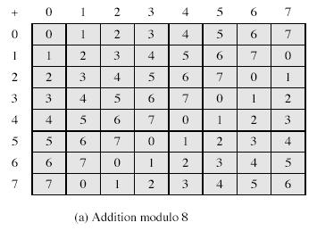
%8 Example
Notes:
From Stallings Table 4.1

Slide 14
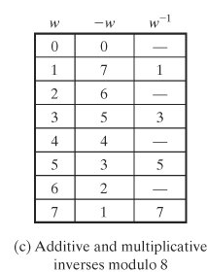
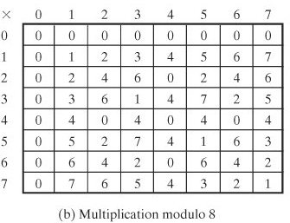
Multiplication and inverses

Slide 15
a%(7), residue classes
[0] [1] [2] [3] [4] [5] [6]
-21 -20 -19 -18 -17 -16 -15
-14 -13 -12 -11 -10 -9 -8
-7 -6 -5 -4 -3 -2 -1
0 1 2 3 4 5 6
7 8 9 10 11 12 13
14 15 16 17 18 19 20
21 22 23 24 25 26 27
28 29 30 31 32 33 34
...

Slide 16
Table 4.2. Properties of Modular Arithmetic for Integers in Z_{n}
Commutative laws
Associative laws
Distributive laws
Identities
Additive inverse (-w)
(w + x) mod n = (x + w) mod n (w x x) mod n = (x x w) mod n
[(w + x) + y] mod n = [w + (x + y)] mod n [(w x x) x y] mod n = [w x (x x y)] mod n
[w + (x + y)] mod n = [(w x x) + (w x y)] mod n [w + (x x y)] mod n = [(w + x) x (w + y)] mod n
(0 + w) mod n = w mod n (1 + w) mod n = w mod n
For each w ∈ Z_{n}, there exists a z such that w + z ≡ 0 mod n
Notes:
b≡c%(n)
but (ab)≡(ac)%(n) for all a,b,c ∈Z_{n}

Slide 17
Relatively prime, Euclid's GCD Algorithm
Numbers with gcd(a,b)=1 are relatively prime
eg GCD(8,15) = 1
an efficient way to find the GCD(a,b), uses theorem that:
gcd(a,b) = gcd(b, a % b), (*)
Euclid's Algorithm to compute GCD(a,b):
gcd(A, B)
While(B>0){
r ← A % B;
A ← B;
B ← r;}
return A
Question is it possible to execute these in one line?
floor(r_{i-2} /r_{i-1}) = r_{i}
Notes:
(*)
1970 = 1 x 1066 + 904 gcd(1066, 904)
1066 = 1 x 904 + 162 gcd(904, 162)
904 = 5 x 162 + 94 gcd(162, 94)
162 = 1 x 94 + 68 gcd(94, 68)
94 = 1 x 68 + 26 gcd(68, 26)
68 = 2 x 26 + 16 gcd(26, 16)
26 = 1 x 16 + 10 gcd(16, 10)
16 = 1 x 10 + 6 gcd(10, 6)
10 = 1 x 6 + 4 gcd(6, 4)
6 = 1 x 4 + 2 gcd(4, 2)
4 = 2 x 2 + 0 gcd(2, 0)

Slide 18
Multiplicative inverse (w⁻¹)
For a given prime, p, the finite field of order p, GF(p) is defined as the set Z_{p} of integers {0, 1,..., p - 1}, together with the arithmetic operations modulo p.
For each w∈Z_{p}, w≠0, there exists a w∈Z_{p}, such that w x z ≡1 (mod p).
Because w is relatively prime to p, if we multiply all the elements of Z_{p} by w, the resulting residues are all of the elements of Z_{p} permuted. Thus, exactly one of the residues has the value 1.

Slide 19
Galois Fields
Galois fields are for polynomial eqns (group thry, number theory, Euclidian geometry): Algebraic solution to a polynomial eqn is related to the structure of a group of permutations associated with the roots of the polynomial, and an equation could be solvable in radicals if one can find a series of normal subgroups of its Galois group which are abelian, or its Galois group is solvable. (wikipedia)
Maths et histoire, evariste-galois.asp.htm
The finite field of order p^{n} is written GF(p^{n}).

Slide 20
A field Z_{n} = {0,1,...,n-1} is a commutative ring in which every nonzero element is assumed to have a multiplicative inverse. ‘a’ is multiplicative inverse to n, iff integer is relatively prime to n.
Definition: If n is a prime p, then GF(p) is defined as the set of integers Z_{p}={0, 1,..., p-1}, + operations in mod(p), then we can say the set Z_{n} of integers {0,1,...,n-1}, + operations in mod(n), is a commutative ring. “Well-behaving”: the results of operations obtained are confined in the field of GF(p)
We are interested in two finite fields of p^{n}, where p is prime,
GF(p)
GF(2^{n})

Slide 21



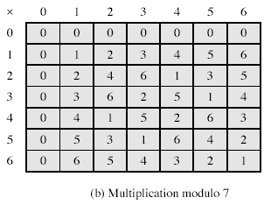
GF(7)
The simplest finite field is GF(2).
Notes:
From Stallings Table 4-3b.

Slide 22
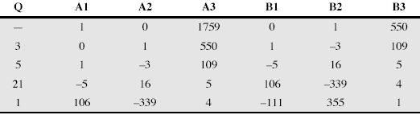
Inverse of 550 in GF(1759)
EXTENDED EUCLID(m, b)
[A1,A2,A3; B1,B2,B3]⬅[1,0,m;0,1,b];
2. if B3==0;
return(A3=gcd(m,b)); //no inverse
3. if B3==1;
return(B3=gcd(m,b));
B2=b^{–1}%m;
4. Q = ⎣A3/B3⎦;
5. [r1,r2,r3]⬅[A1–QB1, A2–QB2, A3–QB3];
6. [A1,A2,A3]⬅[B1,B2,B3];
7. [B1,B2,B3]⬅[r1,r2,r3];
8. goto 2
Finding the Multiplicative Inverse in GF(p)
If (m, b) are relatively prime, then gcd(m, b) = 1, then b has a multiplicative inverse modulo m.

Slide 23
Following the algorithm. Starting with step 0. Denote the quotient at step i by q_{i}.
Carry out each step of the Euclidean algorithm.
After the 2nd step, calculate p_{i} = p_{i-2} – p_{i-1} q_{i-2} %(n); p₀ =0, p₁ =1,
Continue to calculate for p_{i} one step more beyond the last step of the Euclidean algorithm.
If the last nonzero remainder occurs at step k, then if this remainder is 1, x has an inverse and it is p_{k+2}.
(If the remainder is not 1, then x does not have an inverse.)..
(21, 26) p_{i} = p_{i-2} – p_{i-1} q_{i-2} %(m);
26 =1(21)+5; q₀ =1; p₀ = 0;
21 =4(5) +1; q₁ =4; p₁ = 1;
5 =5(1) +0; q₂ =5; p₂ = 0 -1(1)%(26) =-1%26=25.
p₃ = 1 -25(4)%(26) =1-22%26=25.
=-21%26=5.
(5, 26)
26 = 5(5)+1; q₀=5; p₀ =0;
5 = 5(1)+0; q₁=5; p₁ =1;
p₂ = p_{i-2} – p_{i-1} q_{i-2} %(m) = 0-1(5)mod(26)=21;
*******************************************************************************************
Inverse of 550 in GF(1759)
p_{i} = p_{i-2} – p_{i-1} q_{i-2} %(m);
1759 = 3(550)+109; q₀ = 3; p₀ = 0;
550 = 5(109)+5; q₁ = 5; p₁ = 1;
109 = 21(5)+4; q₂ = 21; p₂ = 0 - 1 (3) %(550) = -3.
5 = 1(4)+1; q₃ = 1; p₃ = 1 -(-3) (5) %(550) = 16
4 = 4(1)+0; q₄ = 4; p₄ =-3 - 16(21) %(550) = -339
p₅= 16 - -339 (1)%(550) = 355

Slide 24
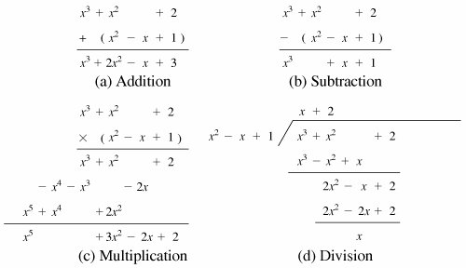
Ordinary Polynomial Arithmetic

Slide 25
Polynomial Arithmetic in Z_{p}
Polynomial in which the coefficients are elements of some field F, is referred as a polynomial over the field F.
Such polynomials set is referred to as a polynomial ring.
Division is possible if the polynomial operations are performed on polynomials over a field, but exact division might not be possible. Tricky?..!!
Within a field, two elements a and b, the quotient a/b is also an element of the field. However, given a ring R that is not a field, division will result in a quotient and a remainder; this is not exact division.
5, 3 within a set S. If S is the set of rational numbers, which is a field, then the result is simply expressed as 5/3 and is an element of S???. Suppose that S is the field Z₇. p=7. In this case, 5/3 = (5 x 3⁻¹) mod 7 = (5 x 5) mod 7 = 4 which is an exact solution. Suppose that S is the set of integers, which is a ring but not a field. Then 5/3 produces a quotient and a remainder: 5/3 = 1 + 2/3; 5 = 1 x 3 + 2, division is not exact over the set of integers.
Division is not always defined, if it is over a coefficient set that is not a field.

Slide 26

Polynomial Arithmetic in Z_{p} if r(x) = 0, g(x)|f(x), g(x) is divisor.
If the coefficient set is the integers, then (5x²)/(3x) does not have a solution, since not in the coefficient set.
Suppose it is performed over Z₇. Then (5x²)/(3x) = 4x which is a valid polynomial over Z₇.
Suppose, degree of f(x) is n, and of g(x) is m, n ≥ m, then degree of the quotient q(x), is (m-n) and of remainder is at most (m–1). Polynomial division is possible if the coefficient set is a field.
r(x) = f(x) mod g(x)
f(x) = x³ + x² + 2 and g(x) = x² - x + 1
q(x)g(x) + r(x) = (x + 2)(x² - x + 1) + x = (x³ + x² - x + 2) + x = x³ + x² + 2 = f(x)
Not convenient for logical operations such as XOR.
Notes:
what is the operation undoes (inverse of this operation that leads to identity) xor and of opretaion xor.. a-+(-a)=, operation +, identity 0..

Slide 27
GF(7)
The simplest finite field is GF(2).
Notes:
From Stallings Table 4-3b.

Slide 28
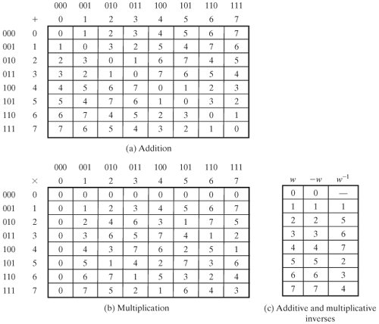
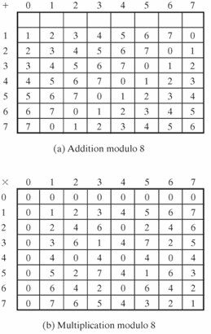
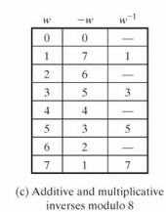
Integer
Occurrences in Z₈
Occurrences in GF(2³)
1 2 3 4 5 6 7
4 8 4 12 4 8 4
7 7 7 7 7 7 7
Z₈
GF(2³)

Slide 29
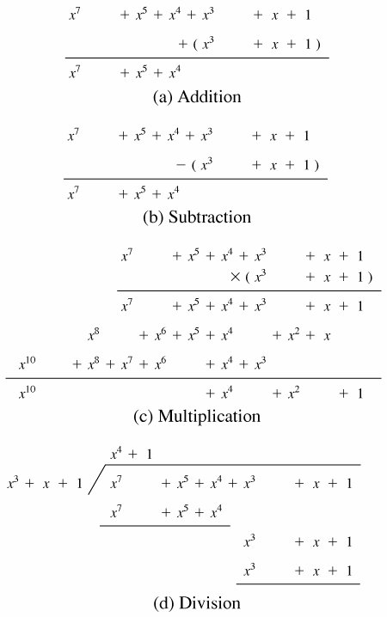
In GF(2), addition and multiplication are equivalent to the XOR, and the logical AND, respectively. Addition and subtraction are equivalent.
Therefore GF(2^{n}) is of most interest in.

Slide 30

Consider the set S of all polynomials of degree n-1 or less over the field Z_{p}. Thus, each polynomial has the form
where each a_{i} takes on a value in the set {0, 1,..., p -1}. There are a total of p^{n} different polynomials in S.
For p = 3 and n = 2, the 3² = 9 polynomials in the set are
0 x 2x
1 x + 1 2x + 1
2 x + 2 2x + 2
For p = 2 and n = 3, the 2³ = 8 the polynomials in the set are
0 x + 1 x² + x
1 x² x² + x + 1
X x² + 1

Slide 31
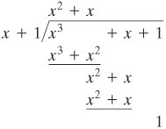
mod 2:
1 + 1 = 1-1 = 0;
1 + 0 = 1 - 0 = 1;
0 + 1 = 0 - 1 = 1.
if f(x) has no divisors other than itself & 1 it is said irreducible (or prime) polynomial, an irreducible polynomial forms a field.
f(x) = x⁴ + 1 over GF(2) is reducible,
because x⁴ + 1 = (x + 1)(x³ + x² + x + 1)
f(x) = x³ + x + 1 is irreducible residual 1.
eg. let f(x) = x³ + x² and g(x) = x² + x + 1 f(x) + g(x) = x³ + x + 1
f(x) x g(x) = x⁵ + x²

Slide 32
Finite Fields Of the Form GF(2^{n})
Polynomials over p^{n}, with n > 1, operations modulo p^{n} do not produce a field. There are structures satisfies the axioms for a field in a set with p^{n} elements, and concentrate on GF(2^{n}).
Motivation Virtually all encryption algorithms, both symmetric and public key, involve arithmetic operations on integers with divisions.
For efficiency: integers that fit exactly into a given number of bits, with no wasted bit patterns, integers in the range 0 through 2^(n)-1, fitting into an n-bit word. Z₂₅₆ versus Z₂₅₁

Slide 33
Polynomial GCD
gcd[a(x), b(x)] is the polynomial of maximum degree that divides both a(x) and b(x).
gcd[a(x), b(x)] = gcd[b(x), a(x)mod(b(x))]
Euclid[a(x), b(x)]
A(x) ⬅ a(x); B(x) ⬅ b(x)
if B(x) = 0 return A(x) = gcd[a(x), b(x)]
R(x) = A(x) mod B(x)
A(x) ⬅ B(x)
B(x) ⬅ R(x)
goto 2

Slide 34
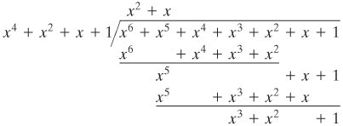
Example of GCD in Z₂ or in GF(2),
Step1, gcd(A(x), B(x))
A(x) = x⁶ + x⁵ + x⁴ + x³ + x² + 1,
B(x) = x⁴ + x² + x + 1; D(x)= x² + x;
R(x) = x³ + x² + 1
Step 2,
A(x) = B(x) = x⁴ + x² + x + 1;
B(x) = R(x) = x³ + x² + 1,
D(x) = x + 1; R(x) =0;
Step 3,
A(x) = B(x) = x³ + x² + 1;
B(x) = R(x) = 0;
gcd(A(x), B(x)) = x³ + x² + 1

Slide 35

GF(2³)

Slide 36
Modular Polynomial Arithmetic
can compute in field GF(2^{n})
polynomials with coefficients modulo 2
whose degree is less than n
hence must reduce modulo an irreducible poly of degree n (for multiplication only)
form a finite field
can always find an inverse
can extend Euclid’s Inverse algorithm to find

Slide 37
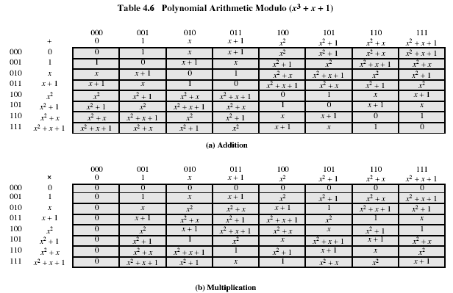
Example GF(2³)
Notes:
Stallings Table 4-6.

Slide 38
Computational Considerations
since coefficients are 0 or 1, can represent any such polynomial as a bit string
addition becomes XOR of these bit strings
multiplication is shift & XOR
cf long-hand multiplication
modulo reduction done by repeatedly substituting highest power with remainder of irreducible poly (also shift & XOR)
Notes:
See text for additional discussion. Reduction comes from observation that if in GF(2^{n}) then irreducible poly g(x) has highest term x^{n} , and if compute x^{n} mod g(x) answer is g(x)- x^{n}

Slide 39
Example
why mod(x³+x+1)!!! for gf(2^3)
in GF(2³) have (x²+1) is 101₂ & (x²+x+1) is 111₂
so addition is
(x²+1) + (x²+x+1) = x
101 XOR 111 = 010₂
and multiplication is
(x+1).(x²+1) = x.(x²+1) + 1.(x²+1)
= x³+x+x²+1 = x³+x²+x+1
011.101 = (101)<<1 XOR (101)<<0 =
1010 XOR 101 = 1111₂
polynomial modulo reduction (get q(x) & r(x)) is
(x³+x²+x+1 ) mod (x³+x+1) = 1.(x³+x+1) + (x²) = x²
1111 mod 1011 = 1111 XOR 1011 = 0100₂
Notes:
Show here a few simple examples of addition, multiplication & modulo reduction in GF(2³).
Note the long form modulo reduction finds p(x)=q(x).m(x)+r(x) with r(x) being the desired remainder.

Slide 40
Summary
have considered:
concept of groups, rings, fields
modular arithmetic with integers
Euclid’s algorithm for GCD
finite fields GF(p)
polynomial arithmetic in general and in GF(2^{n})

Slide 41
Aim
To understand the principles of encryption algorithms, conventional and public key cryptography.
To have a detailed knowledge about authentication, hash functions and application level security mechanisms.

Slide 42
Agenda
Aim
Introduction
Background
Definitions
Computer Security
Personnel Security
Network Security
Internet security
Summary
Test your understanding
References

Slide 43
Introduction
The art of war teaches us to rely not on the likelihood of the enemy's not coming, but on our own readiness to receive him; not on the chance of his not attacking, but rather on the fact that we have made our position unassailable.
—The Art of War, Sun Tzu

Slide 44
Agenda
Aim
Introduction
Background
Definitions
Computer Security
Personnel Security
Network Security
Internet security
Summary
Test your understanding
References

Slide 45
Background
Information Security requirements have changed in recent times
traditionally provided by physical and administrative mechanisms
computer user requires automated tools to protect files and other stored information
use of networks and communications links requires measures to protect data during transmission
Notes:
Traditionally information security provided by physical (eg. rugged filing cabinets with locks) and administrative mechanisms (eg. Personnel screening procedures during hiring process).
Growing computer use implies a need for automated tools for protecting files and other information stored on it.
This is especially the case for a shared system, such as a time-sharing system, and even more so for systems that can be
accessed over a public telephone network, data network, or the Internet.

Slide 46
Agenda
Aim
Introduction
Background
Definitions
Computer Security
Personnel Security
Network Security
Internet security
Summary
Test your understanding
References

Slide 47
Definitions
Computer Security - generic name for the collection of tools designed to protect data and to thwart hackers
Network Security - measures to protect data during their transmission
Internet Security - measures to protect data during their transmission over a collection of interconnected networks
Notes:
the term network security is sometimes misleading.

Slide 48
Agenda
Aim
Introduction
Background
Definitions
Computer Security
Personnel Security
Network Security
Internet security
Summary
Test your understanding
References

Slide 49
Internet security
our focus is on Internet Security
consists of measures to deter, prevent, detect, and correct security violations that involve the transmission of information
Notes:
important: there is transimission. There will be both a sender and a receiver. Keep that in mind. The information is not store in ONE location, but at least two. That makes the problem much harder.

Slide 50
Agenda
Aim
Introduction
Background
Definitions
Computer Security
Personnel Security
Network Security
Internet security
Summary
Test your understanding
References

Slide 51
Summary
Today’s lecture provides a general overview of the cryptography and network security.
Next class we will discuss the network security services and mechanisms, and of the types of attacks they are designed for.

Slide 52
Test your understanding
Define computer security.
What is network security?

Slide 53
References
1. William Stallings, Cryptography and Network Security, 6th Edition, Pearson Education, March 2013.
2. Charlie Kaufman, Radia Perlman and Mike Speciner, “Network Security”, Prentice Hall of India, 2002.

